Slide 1
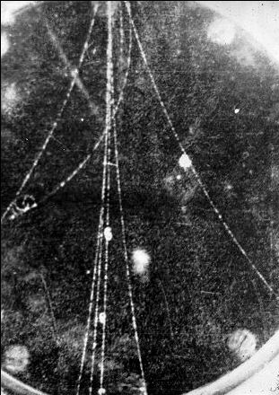
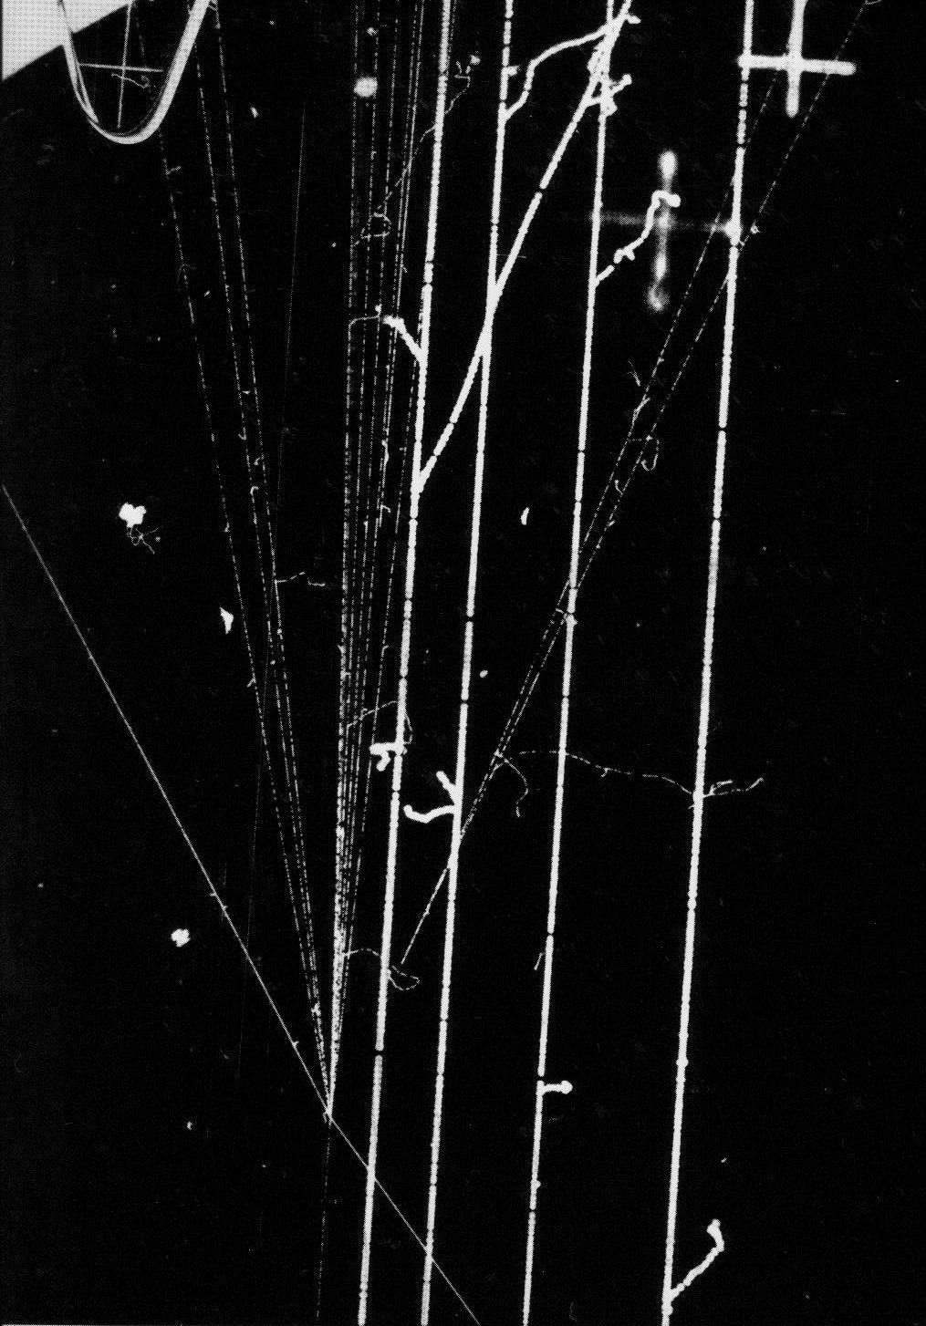
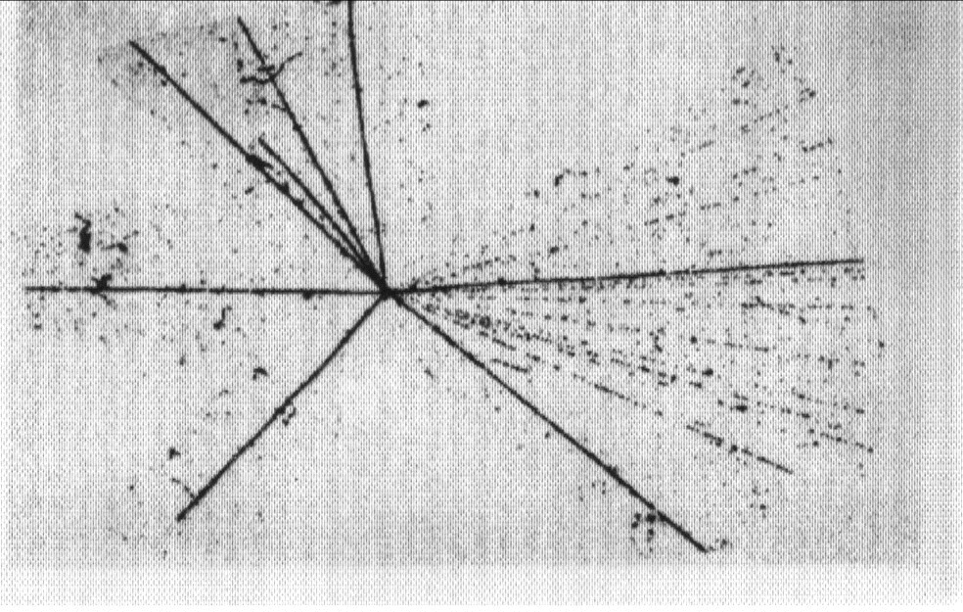
FROM MWPC TO MPGD:
AN HISTORICAL OVERVIEW
Fabio Sauli - CERN
CLASSIC RADIATION IMAGING DETECTORS
~ 1930
CLOUD CHAMBER
~1940
EMULSIONS
~ 1960
BUBBLE CHAMBER
DRD1 Gaseous Detectors School - MSU 8-17 July 2026

Slide 2
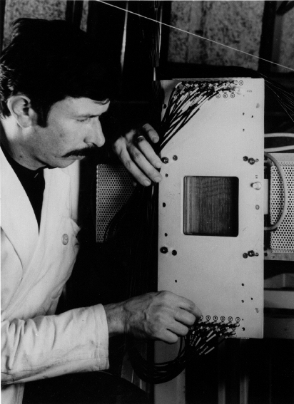
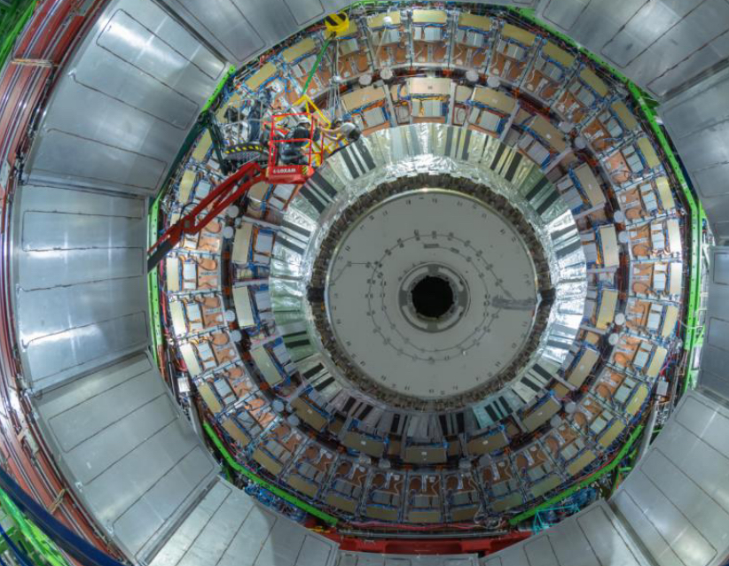
1968:
First MWPC
2018: CMS GEM Muon Endcap
Other Lectures at this School
DRD1 Gaseous Detectors School - MSU 8-17 July 2026

Slide 3
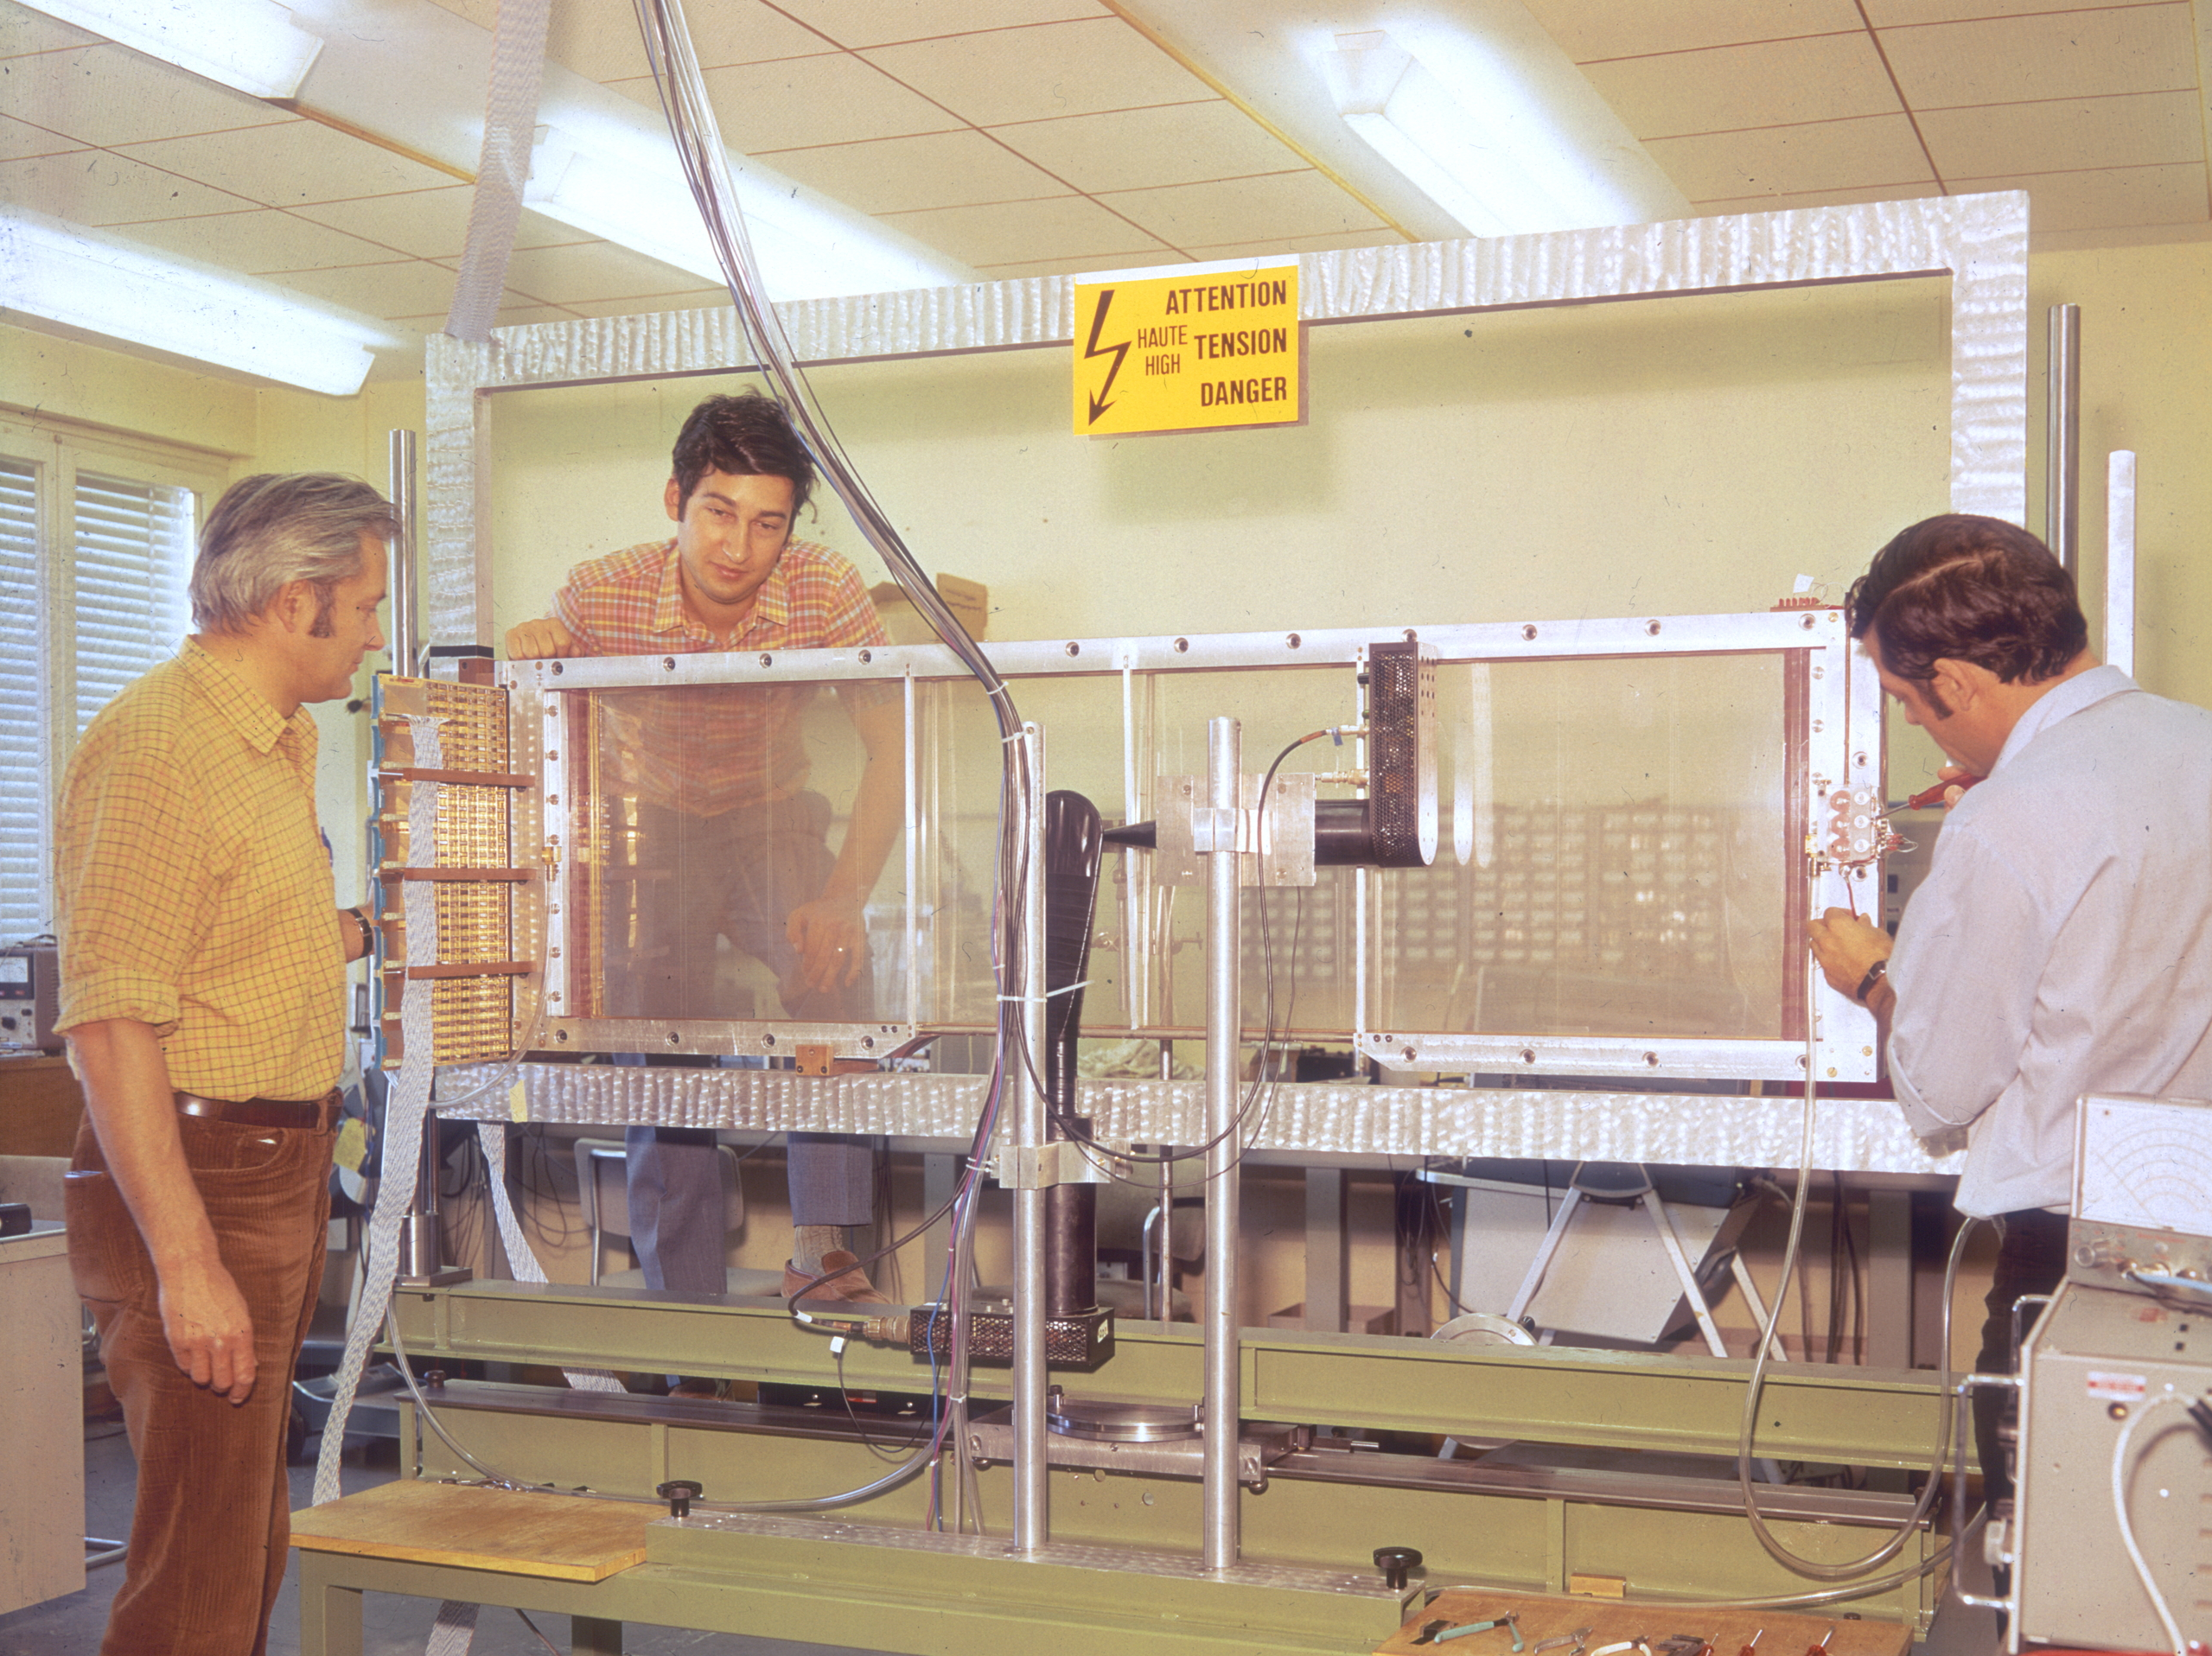
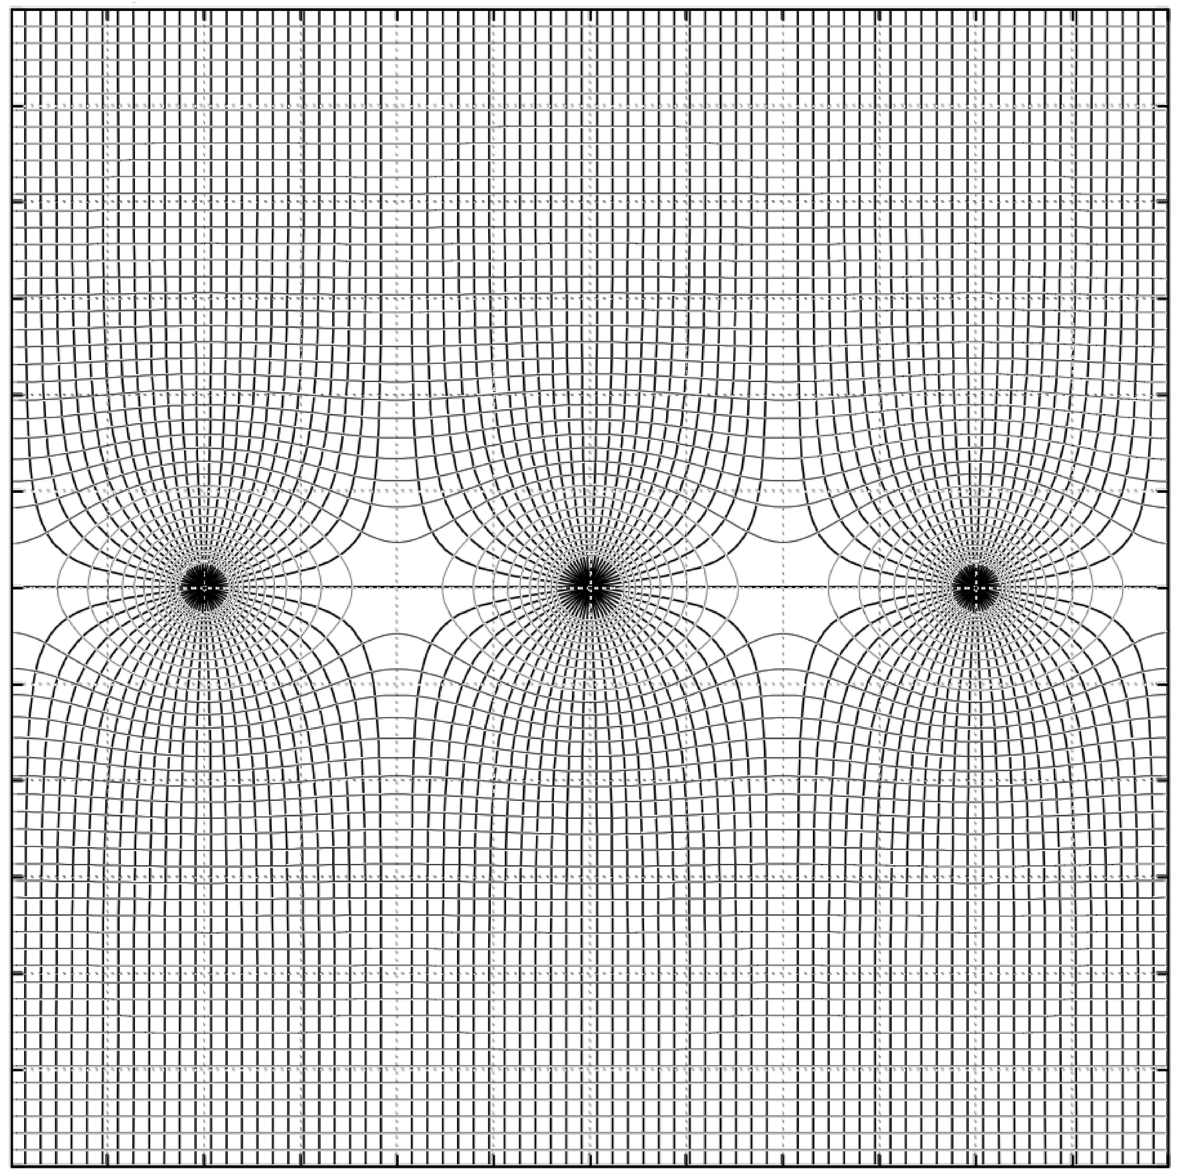

1968: MULTIWIRE PROPORTIONAL CHAMBER (MWPC)
LARGE MWPC (CERN 1970)
Georges Charpak (CERN)
Sauli
-HV
Charpak
Drift
Ionization
+
GND
Multiplication
-HV
G. Charpak et al,
Nucl. Instr. Meth. 62(1968)282
Georges Charpak
1992

Slide 4
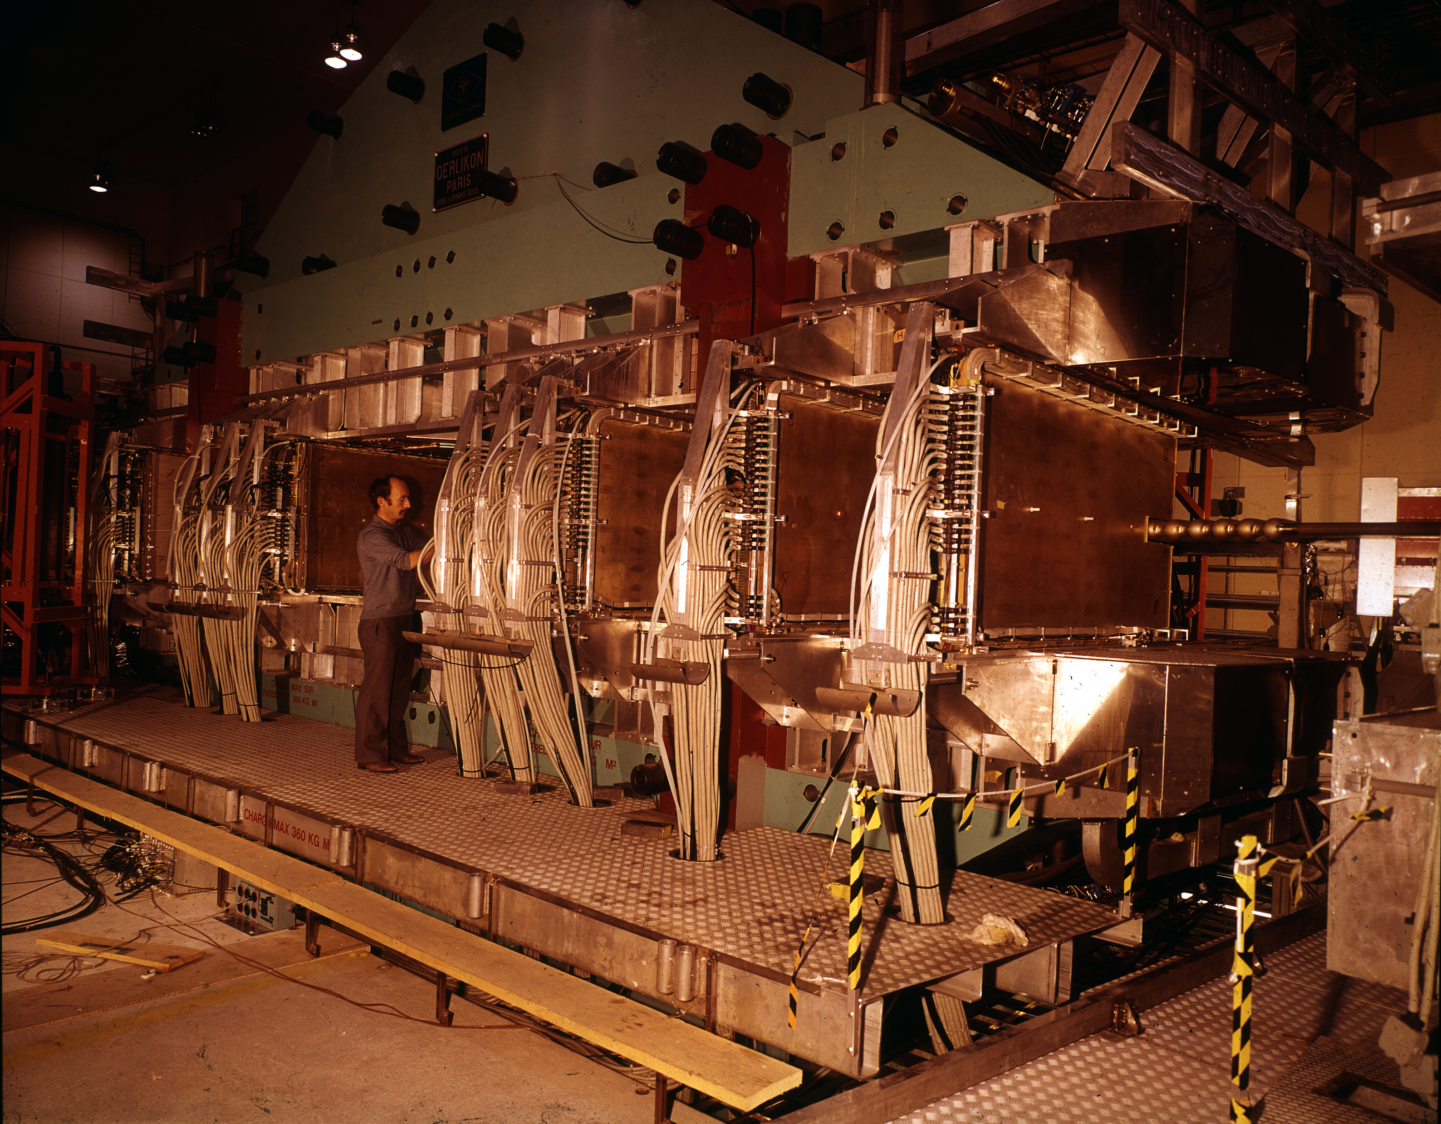
MULTIWIRE PROPORTIONAL CHAMBER SYSTEMS
1973: SPLIT FIELD MAGNET DETECTOR AT CERN'S p-p STRORAGE RING
p-p collisions 62+62 GeV
*
*
*
*
*
*
*
*
*
*
+
*
*
*
*
*
*
*
*
*
*
*
*
*
*
*
*
*
*
*
*
*
*
Optimized to detect Fractional Charges…
… but no free Quarks!

Slide 5
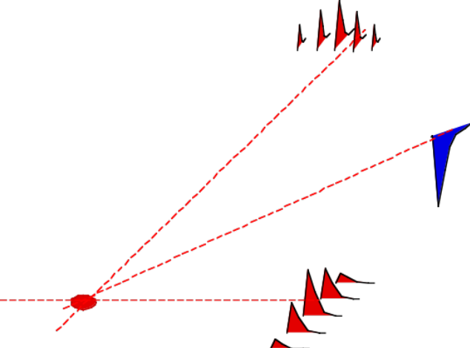
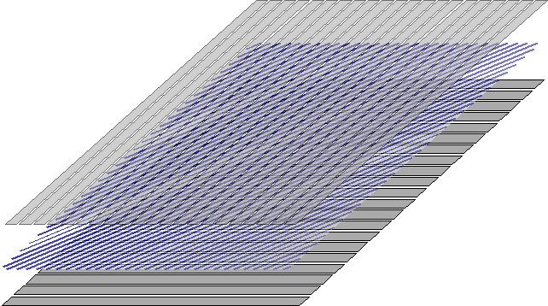
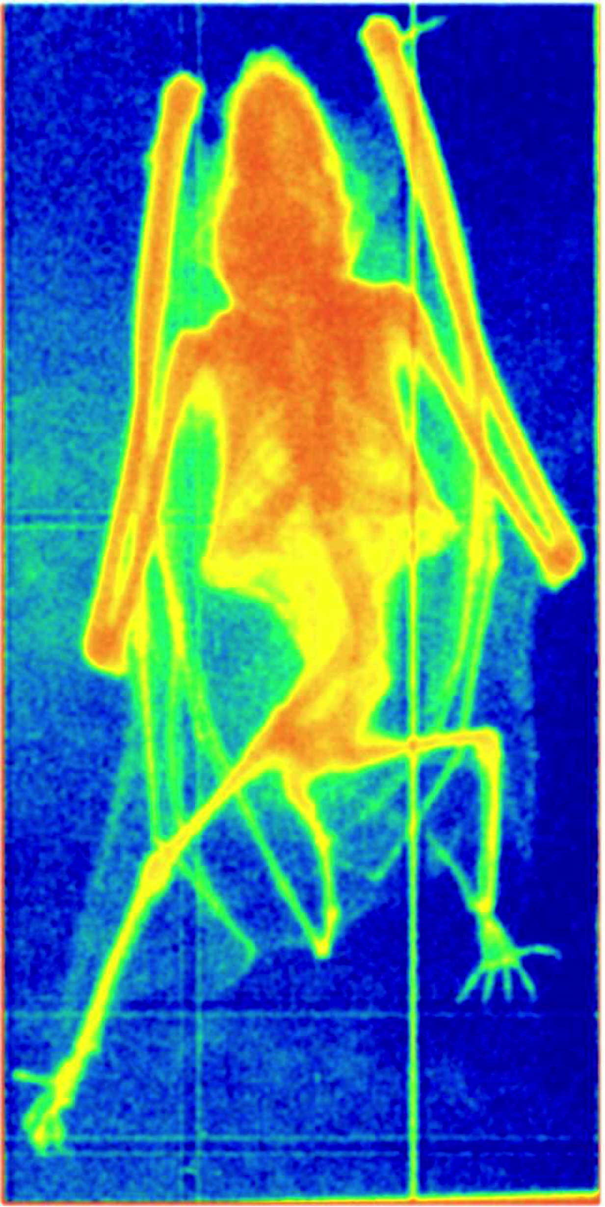
MWPC: TWO-DIMENSIONAL READOUT
INDUCED CHARGE PROFILES ON CATHODES: SUB-MM 2-D LOCALIZATION
SOFT X-RAY RADIOGRAPHY OF A BAT
G. Charpak and F. Sauli,
Nucl. Instr. and Methods 113(1973)381

Slide 6
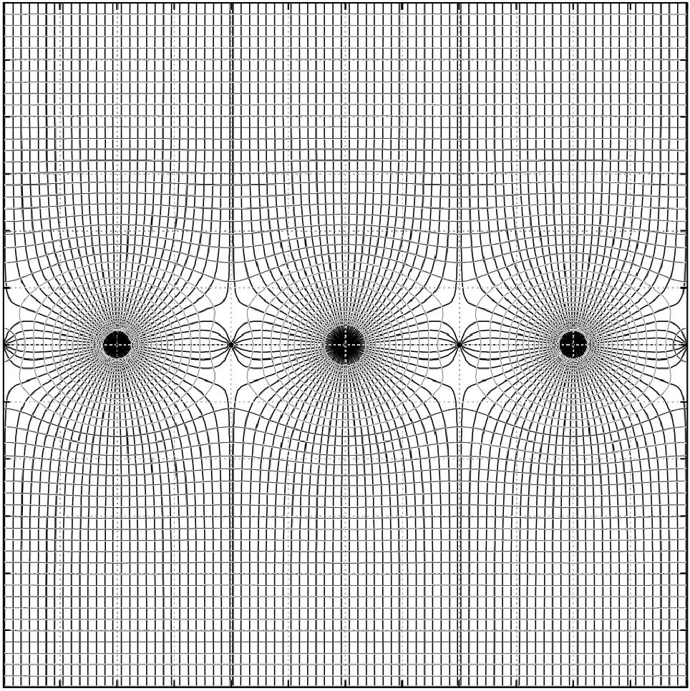
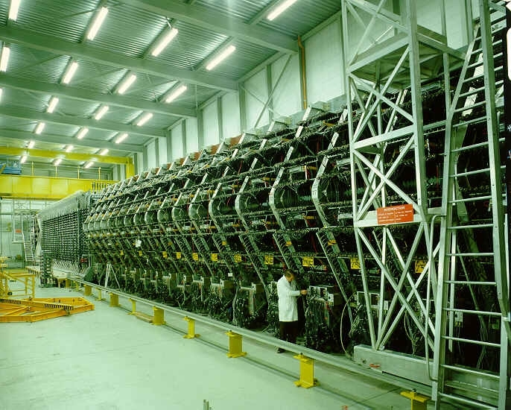
MULTIWIRE DRIFT CHAMBERS
Electron Drift Time t s = w t
➙
WA1 NEUTRINO DETECTOR AT CERN:
Neutral Currents, Neutrino Oscillations
s
A. H. Walenta et al
Nucl. Instr. Meth. 92(1971)373
G. Marel et al,
Nucl. Instr. Meth. 141(1977)43

Slide 7
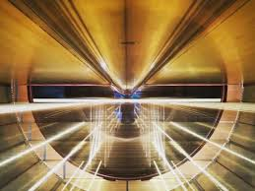
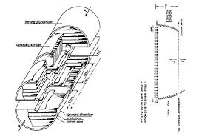
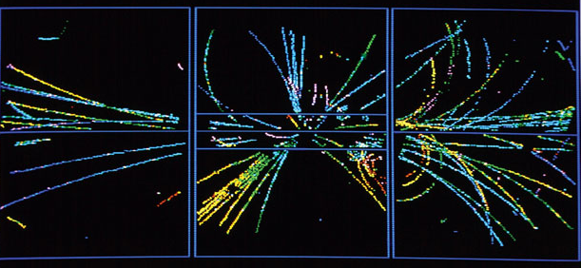
1983: UA1 DRIFT CHAMBERS SYSTEM
UA1 EXPERIMENT - CERN PROTON-ANTIPROTON COLLIDER
XY FROM WIRE CHAMBER
Z FROM ELECTRONS DRIFT TIME
1984
_
pp COLLISION (1982):
Discovery of the W and Z bosons
C. Rubbia, Simon van der Meer
1984

Slide 8
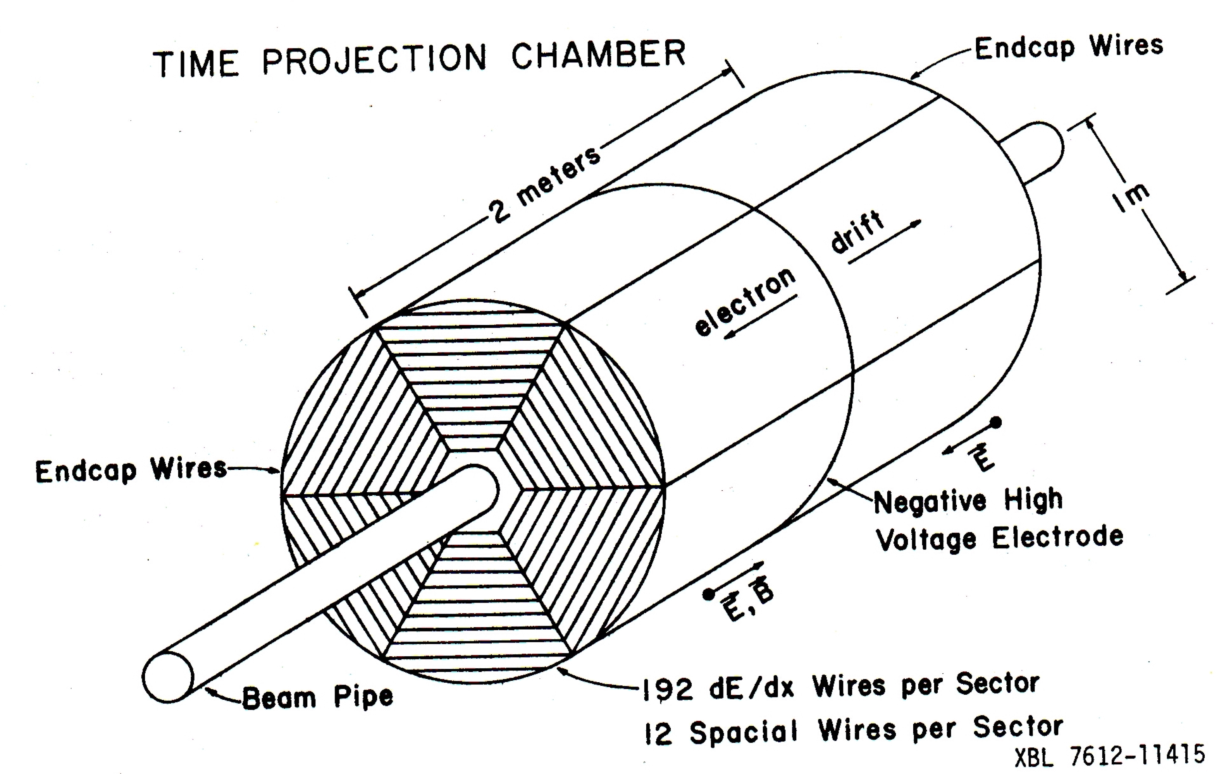
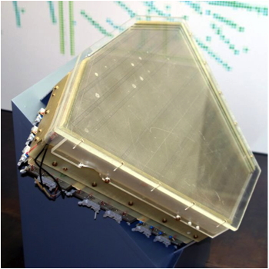
1970: TIME PROJECTION CHAMBER (TPC)
David Nygren
PEP-4 BNL-SLAC TIME PROJECTION CHAMBER
MWPC sector
D. Nygren and J. Marx
Phys. Today 31(1978)46
READOUT:
Drift Time on Anode Wires
XY Coordinates on Cathode Pad Rows

Slide 9
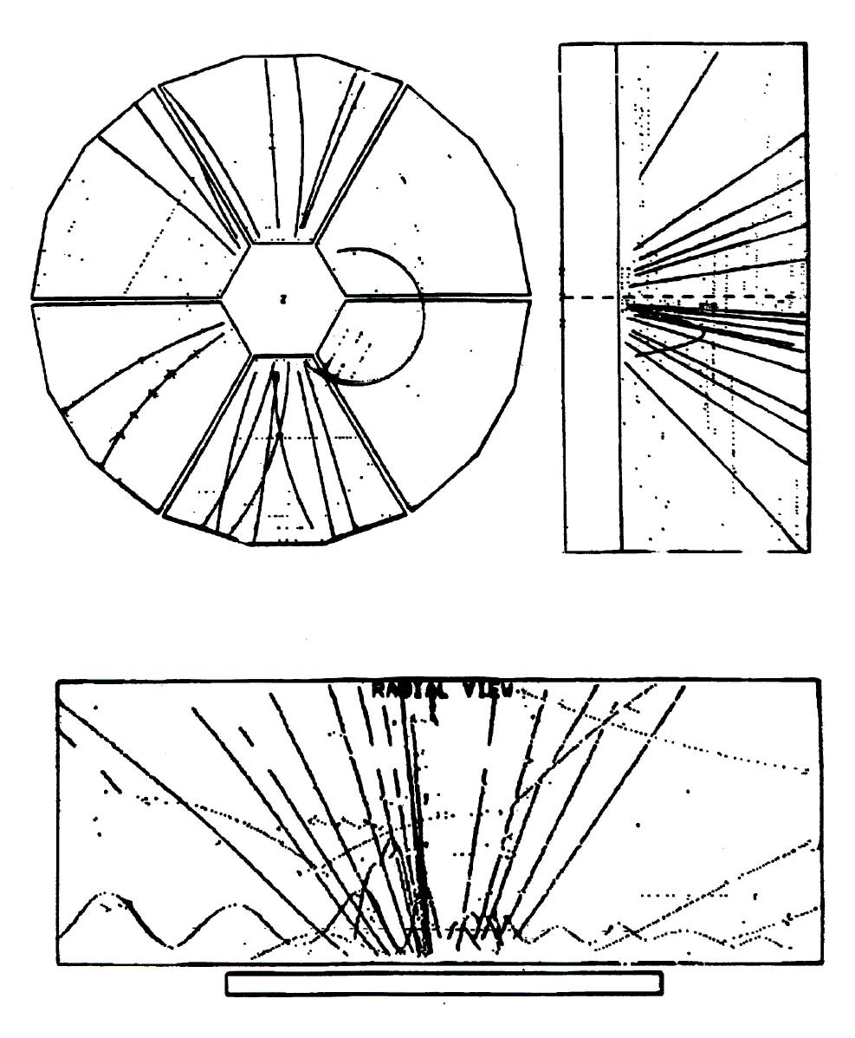
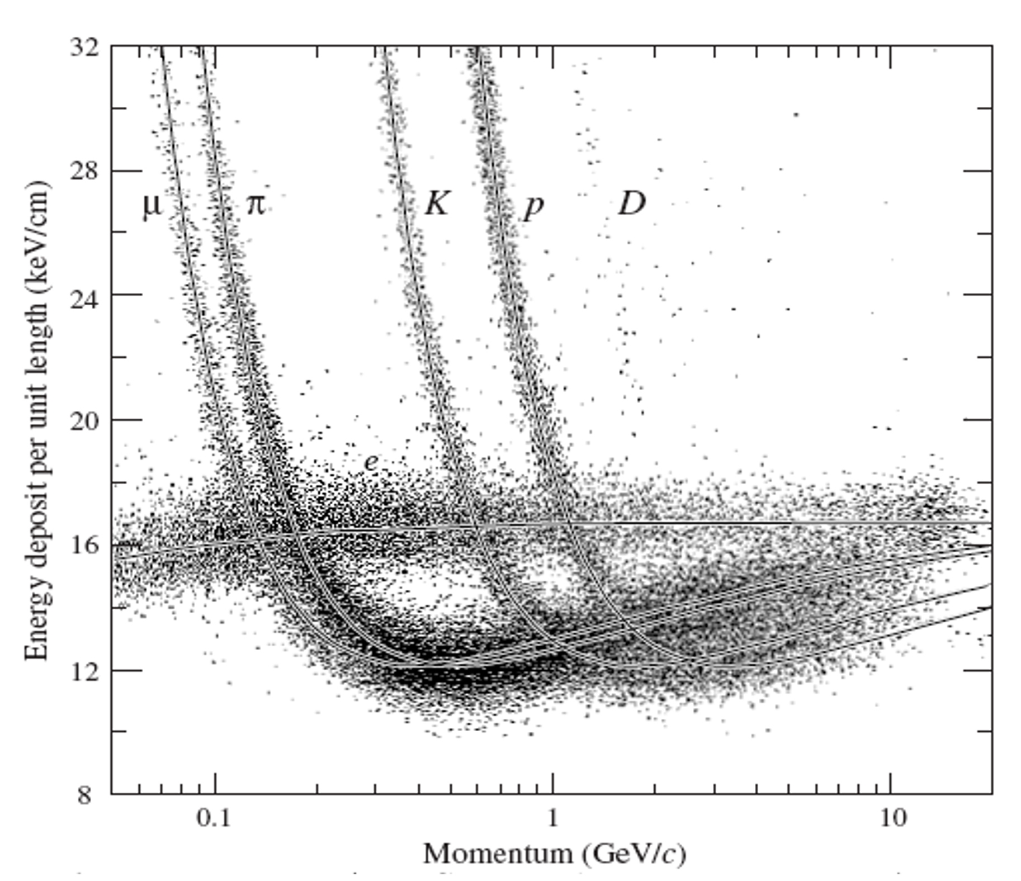
TIME PROJECTION CHAMBER (TPC)
TREE-DIMENSIONAL TRACKING
Particle identification:
Differential Energy Loss dE/dx

Slide 10
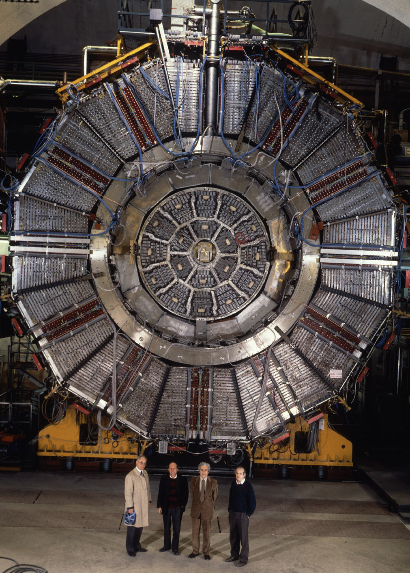
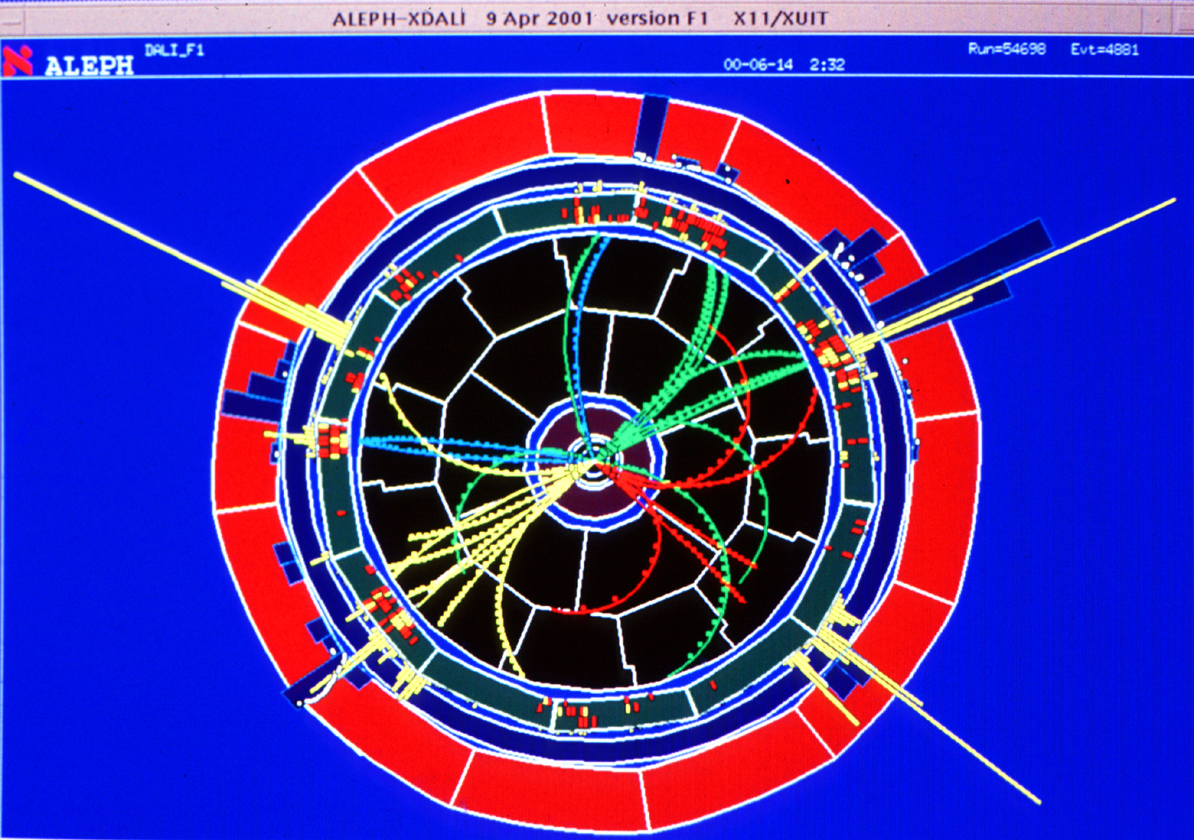
1988-2000: TIME PROJECTION CHAMBERS AT CERN'S LEP
ALEPH TPC
DELPHI TPC
A. Brand et al
Nucl.Instr. Meth. A283(1989)567
D. Decamp et al
Nucl. Instr. Meth. A294(1990)121

Slide 11
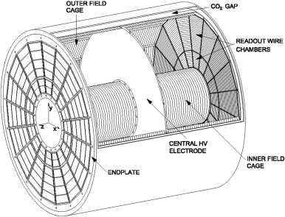
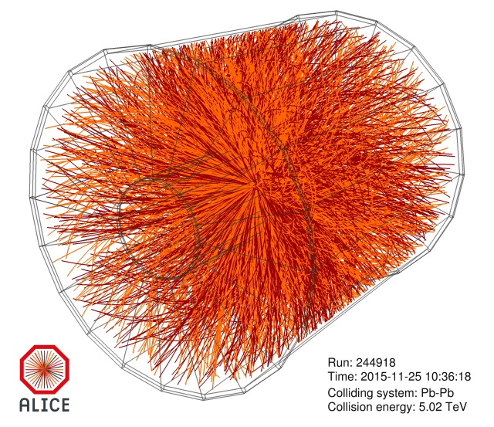
~2000: ALICE TPC AT LHC
Pb-Pb Collision at 5 TeV
2x2.5 m drift – 90 m³
J. Alme et al
Nucl. Instr. Meth. A622(2010)316
MWPC LIMITATIONS:
TWO-TRACKS RESOLUTION ~ mm
RATE CAPABILITY ~ 10⁴ mm⁻² s⁻¹
AGING
HARD TO BUILD, FRAGILE

Slide 12
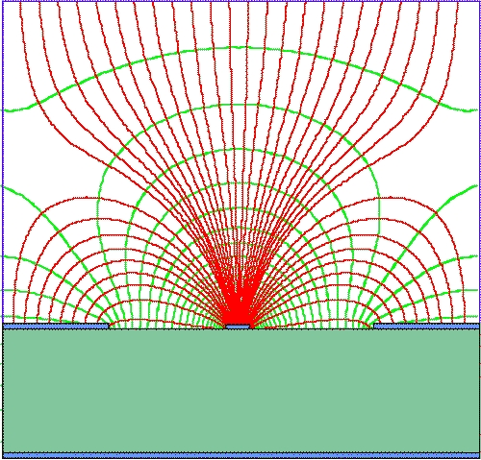
1988: MICROSTRIP GAS COUNTER (MSGC)
Anton Oed (ILL Grenoble)
ALTERNATING ANODE AND CATHODE STRIPS ENGRAVED ON GLASS WITH PHOTOLITHOGRAPHY
100-200 µm
A. Oed, Nucl. Instr. Meth. 263(1988)351
Space Accuracy ~ 50 µm
Two-track Resolution ~ 500 µm
Rate capability ~ 10⁶ mm⁻² s⁻¹

Slide 13
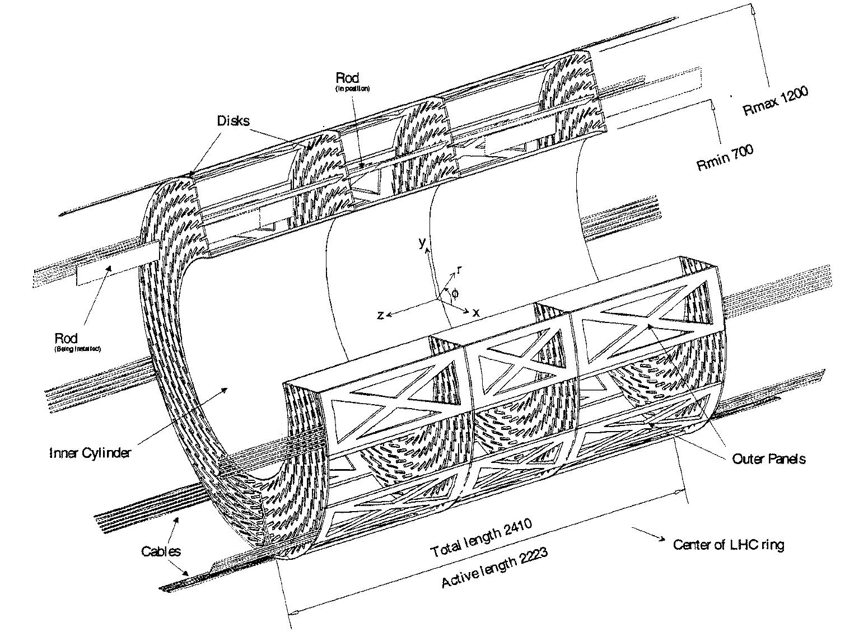
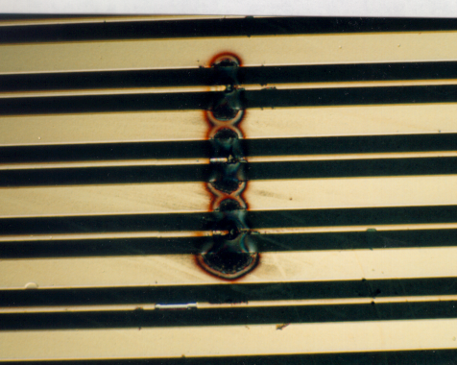
MICROSTRIP GAS COUNTER (MSGC)
CMS MSGC BARREL TRACKER (1999)
DISCHARGE PROBLEMS AND
LONG TERM RELIABILIY
~ 15,000 MSGCs
GAIN TO DETECT MIPs (100 e⁻) : ~10⁴ Δ Q ~ 10⁶
~ MeV NEUTRON CONVERSION (~ 10⁴ e⁻) ΔQ ~ 10⁸ >> RAETHER LIMIT ~ 10⁷!

Slide 14
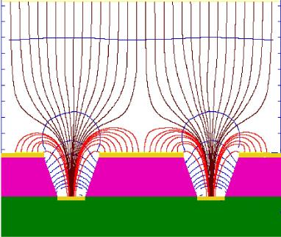
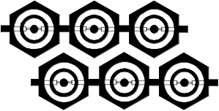
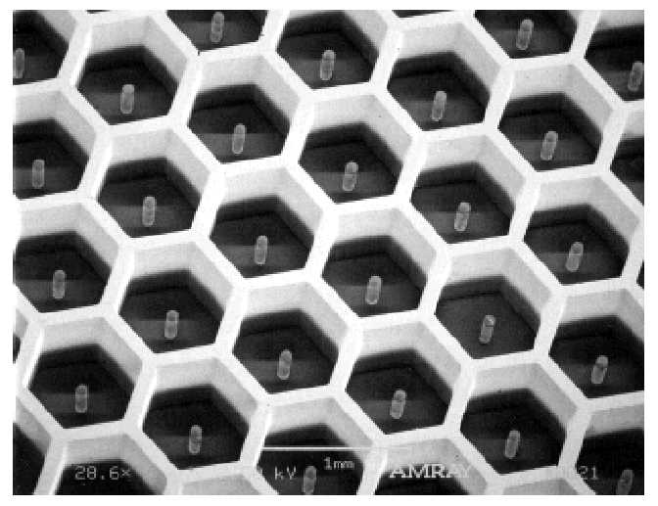
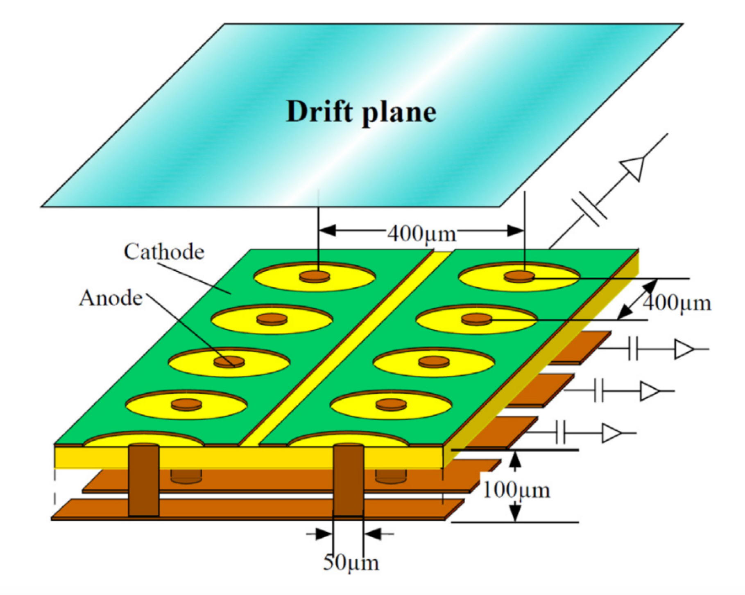
1999: NEW MICRO-PATTERN GASEOUS DETECTORS (MPGD)
MICRO GROOVE (R. Bellazzini, 1999)
MICRODOT (S.Biagi, 1995)
MICRO-PIN ARRAY (P. Rehak, 2000)
MICRO-PIXEL DETECTOR (A.Ochi, 2001)

Slide 15
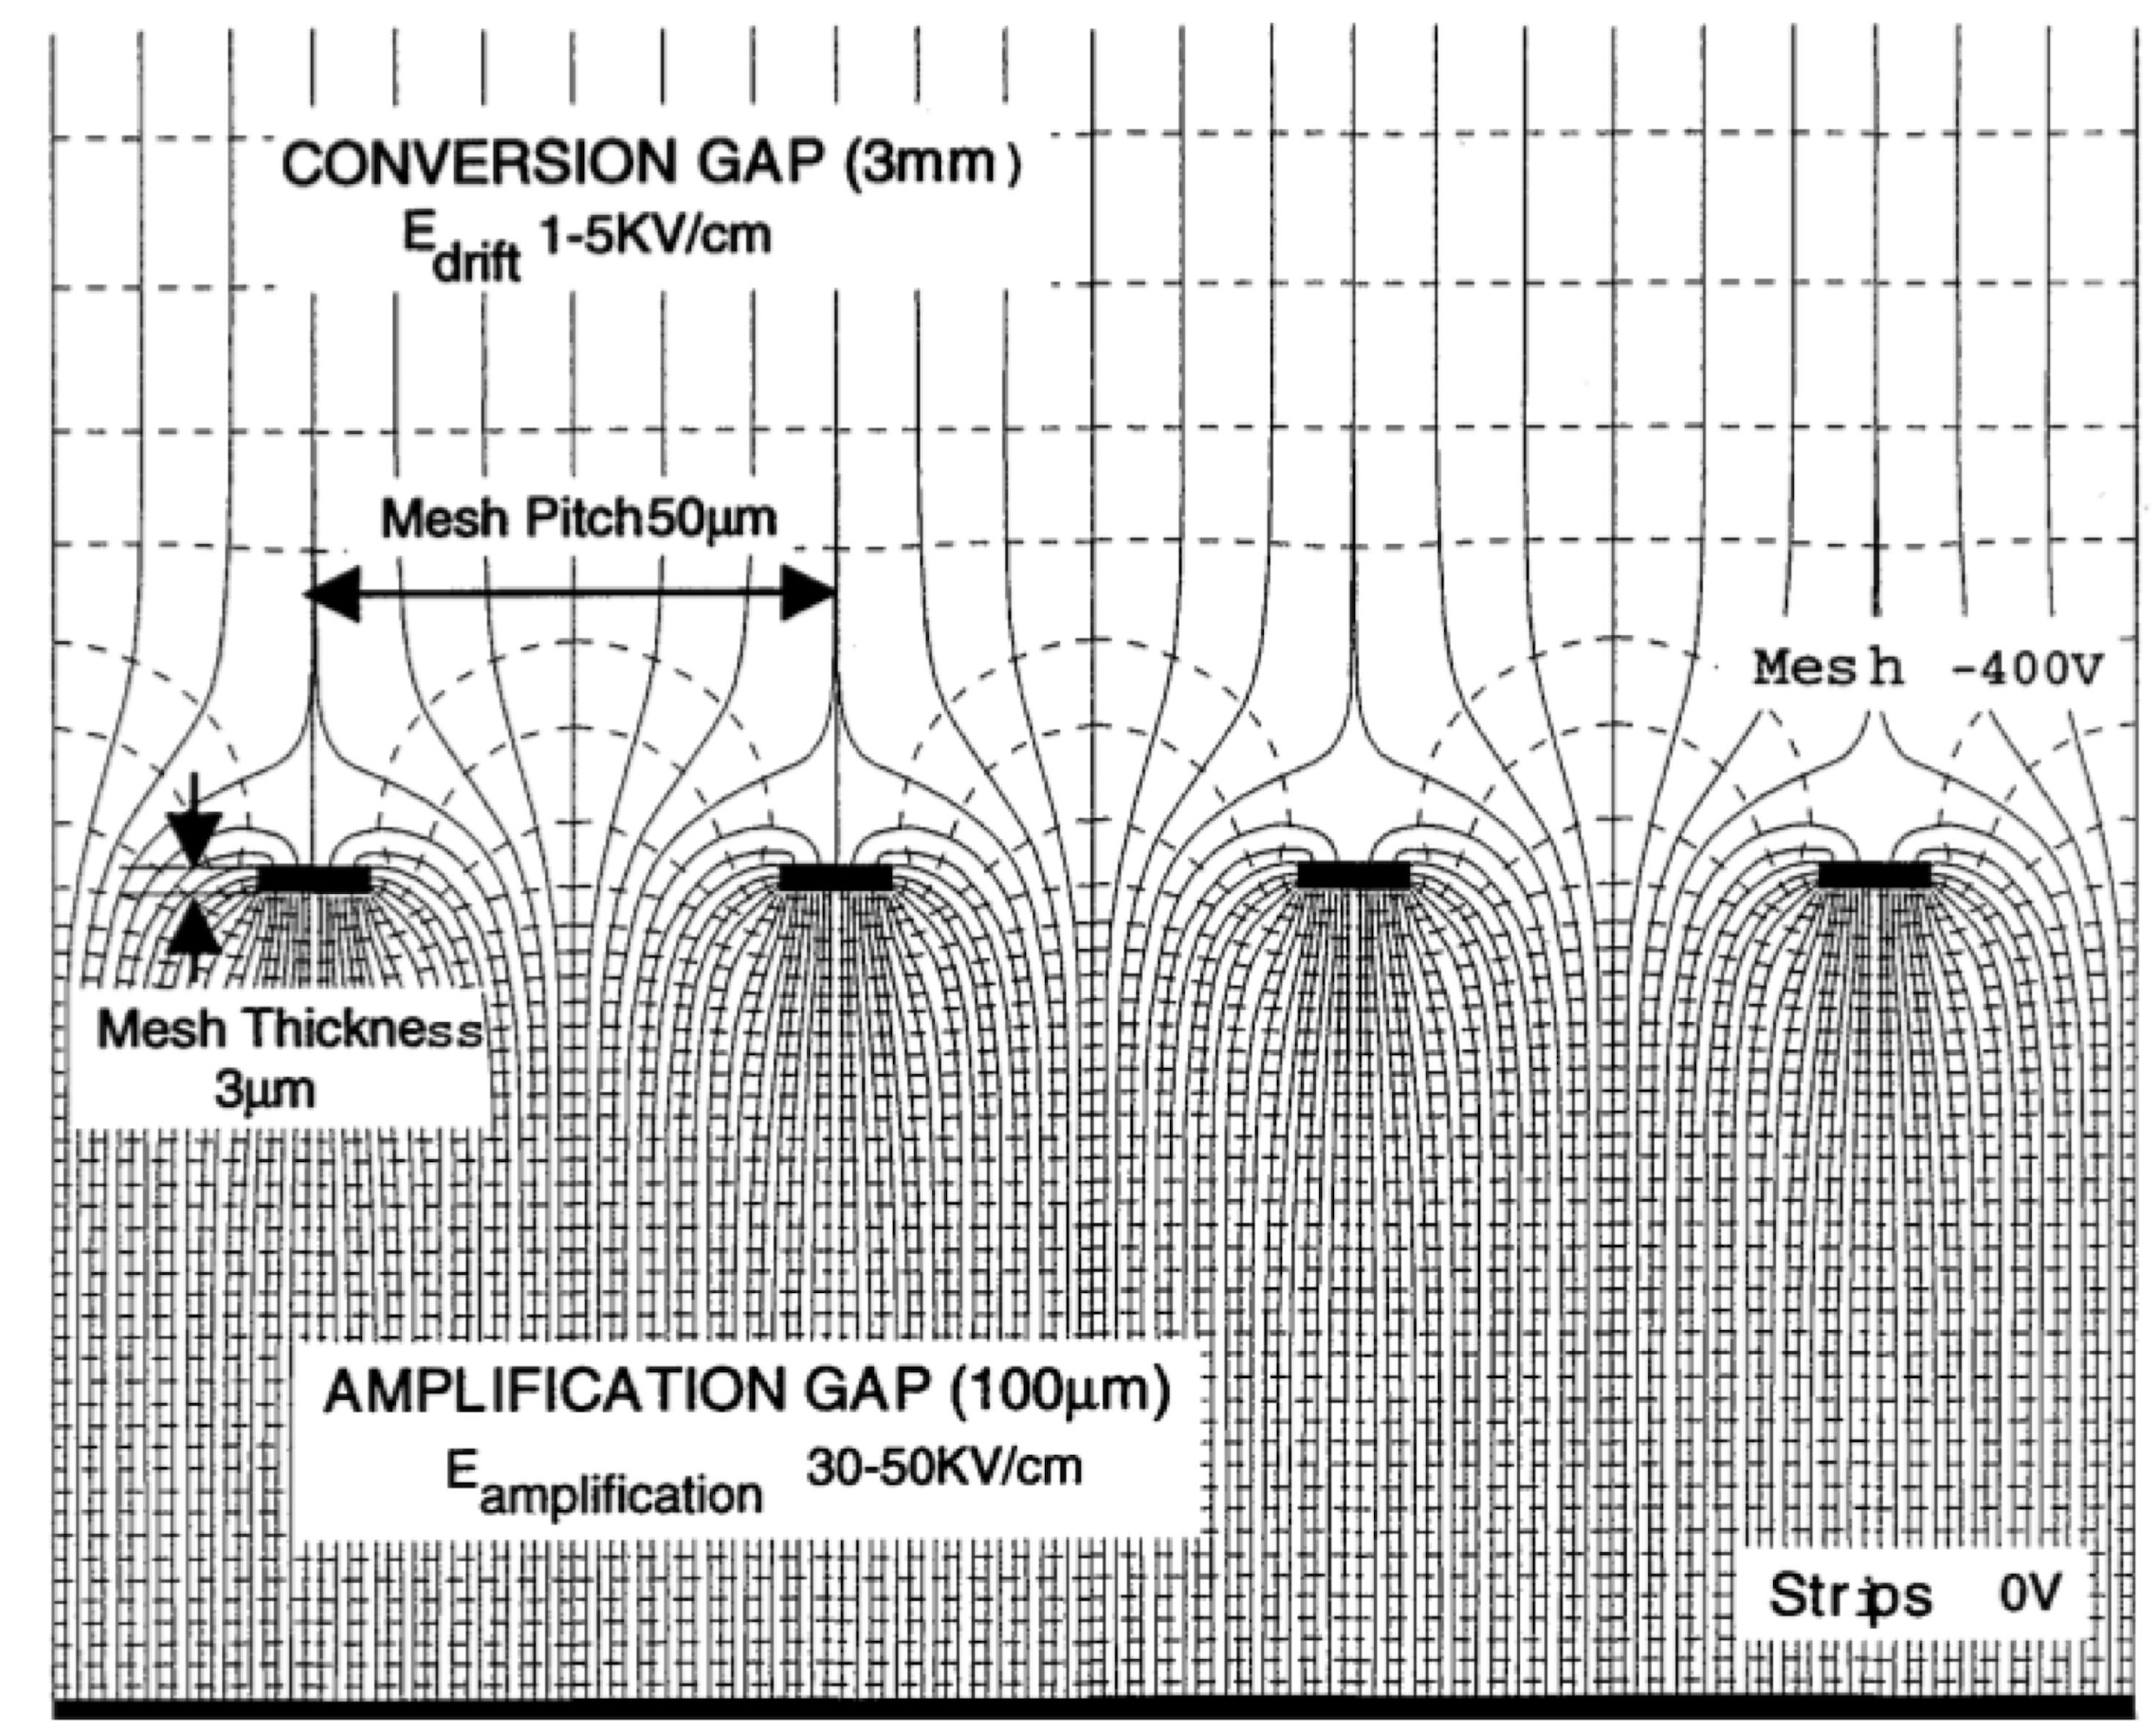
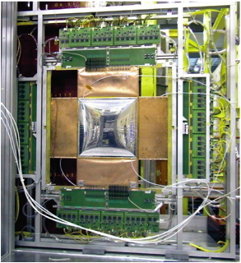
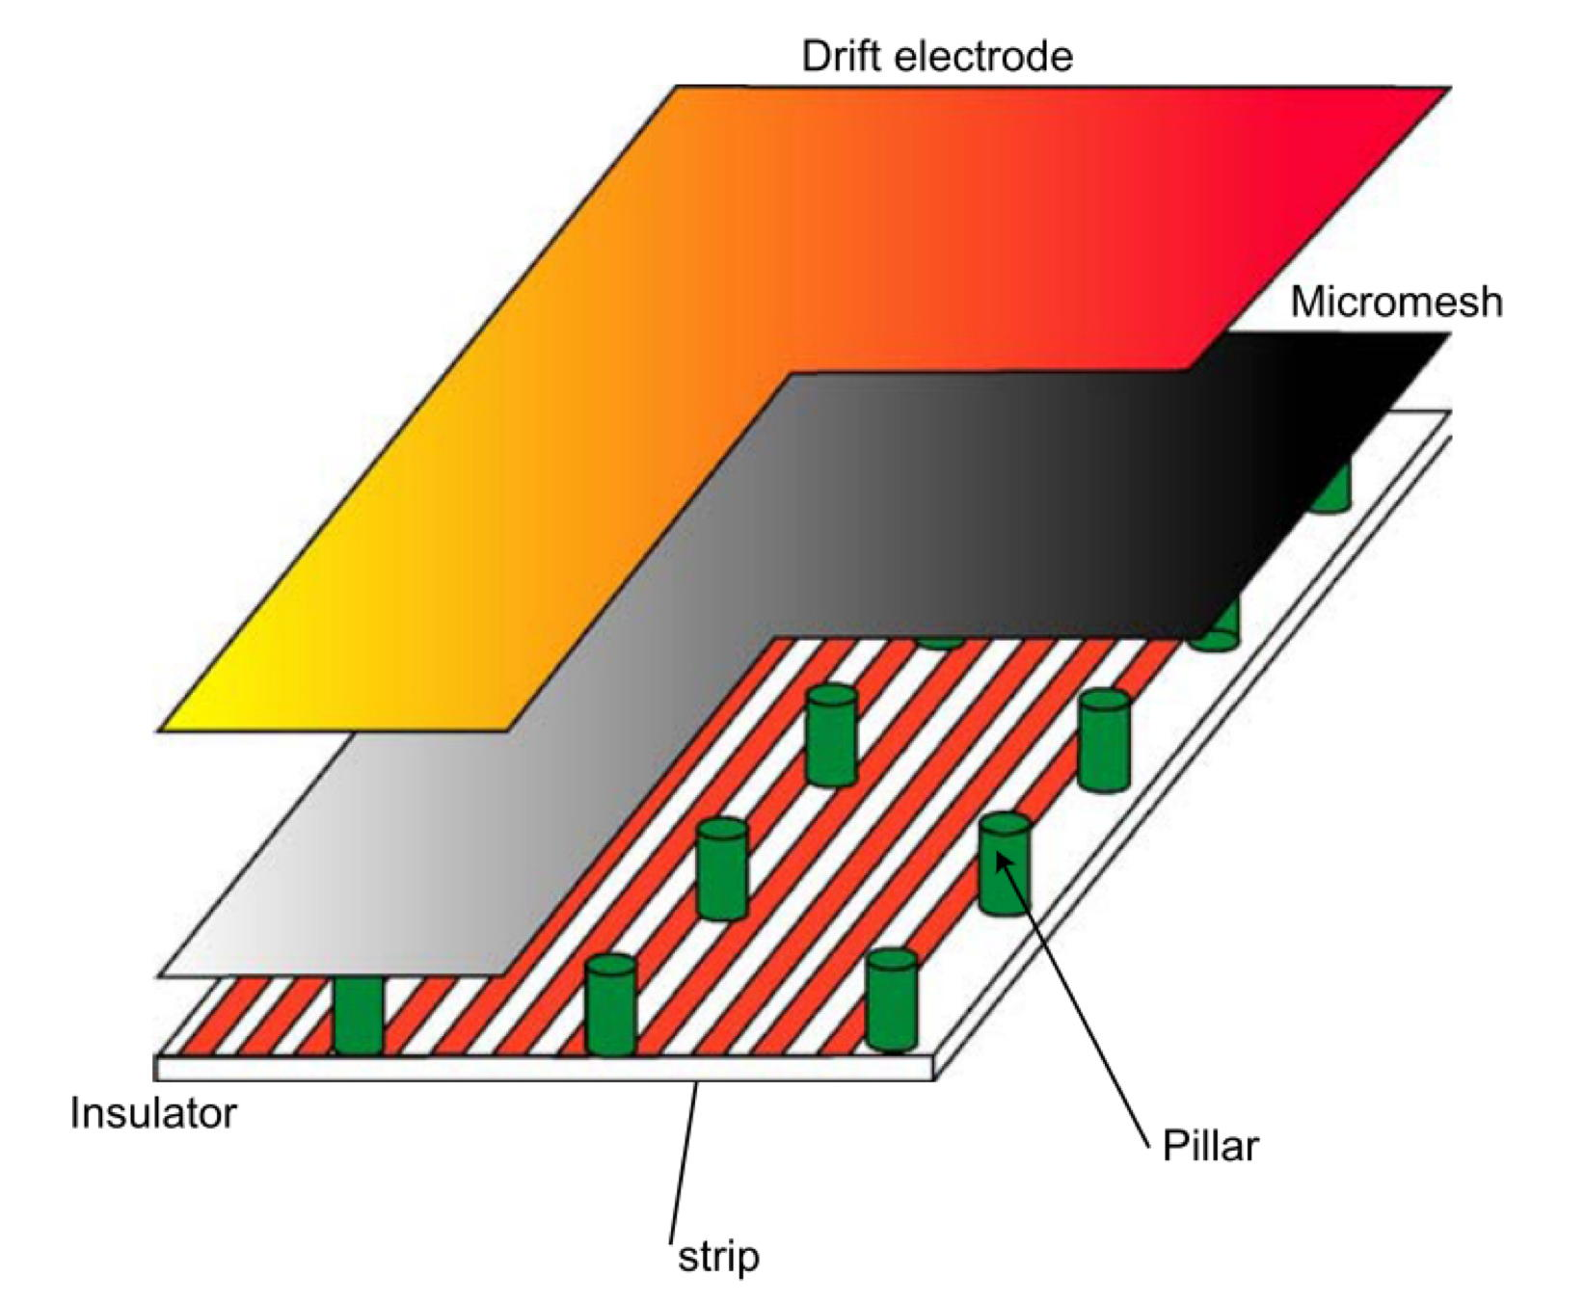
1996: MICRO-MESH GASEOUS CHAMBER (MICROMEGAS)
2001: COMPASS SPECTROMETER AT CERN
12 PLANES 40x40 cm² aCTIVE
POSITION ACCURACY ~ 70 µm
C. Bernet et al,
Nucl. Instr. Meth. A536(2005)61
I. Giomataris et al,
Nucl. Instr. Meth. A376(1996)29

Slide 16
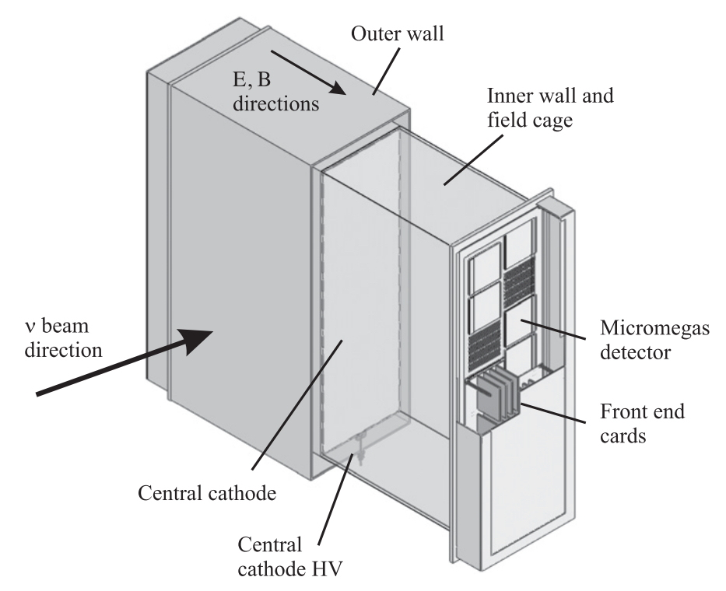
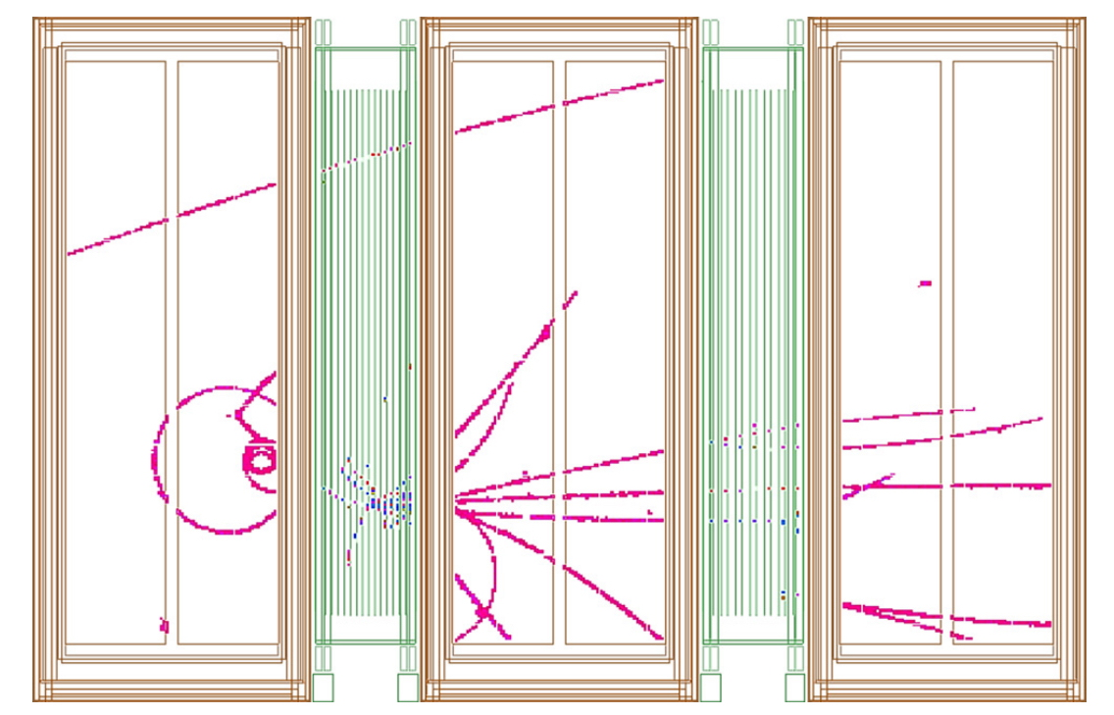
MICROMEGAS
TIME PROJECTION CHAMBER FOR THE T2K NEAR DETECTOR
DOUBLE NEUTRINO INTERACTION
N. Abgrall et al
Nucl. Instr. Meth. A637(2011)25

Slide 17
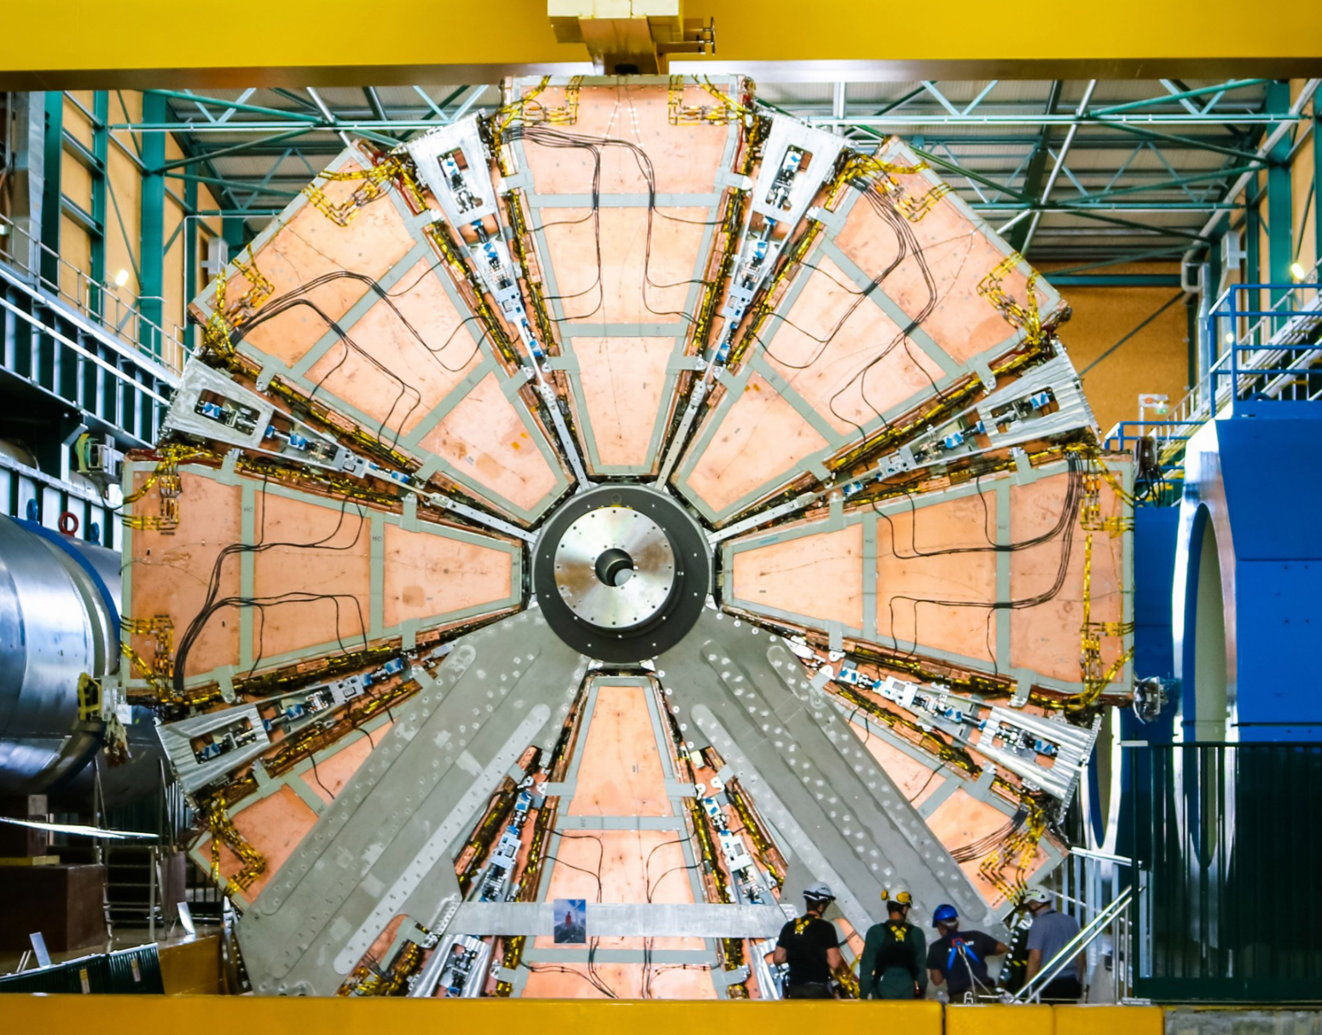
MICROMEGAS
ATLAS MICROMEGAS UPGRADE
1280 m² active surface
128 detectors
4 layers
2 to 3 m² area2.1 10⁶ readout channels
T. Alexopoulos et al, Nucl. Instr. Meth. A955(2020)162086

Slide 18
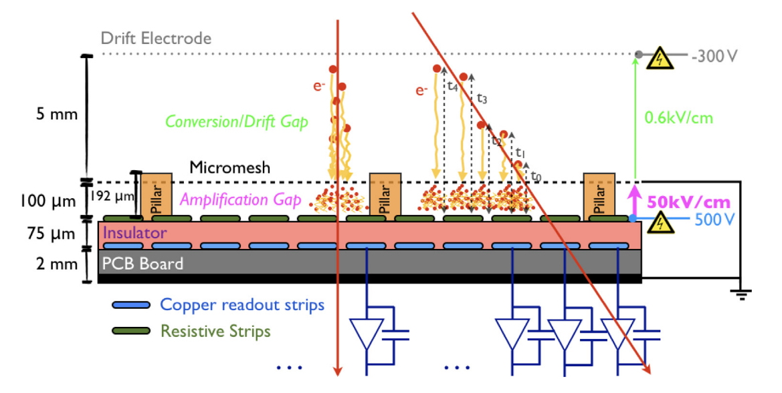
SPARK PROTECTION: RESISTIVE MICROMEGAS
HIGH RESISTIVITY ANODE:
EFFECTIVE DISCHARGES SUPPRESSION
F. Kruger, Nucl. Instr. Meth. A845(2017)248

Slide 19
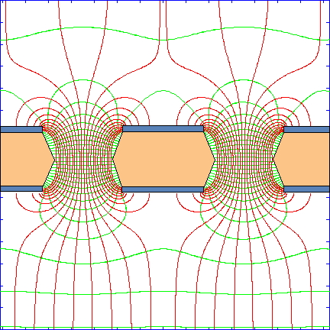
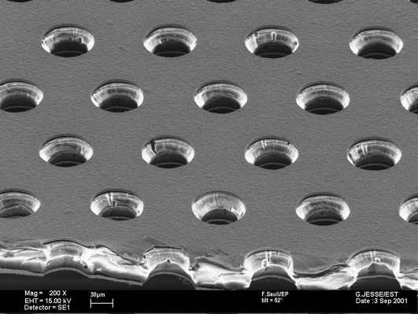
1997: GAS ELECTRON MULTIPLIER (GEM)
50 µm Cu-coated Kapton
70 µm Ø
140 µm
F. Sauli, Nucl. Instr. Meth. A386(1997)531

Slide 20
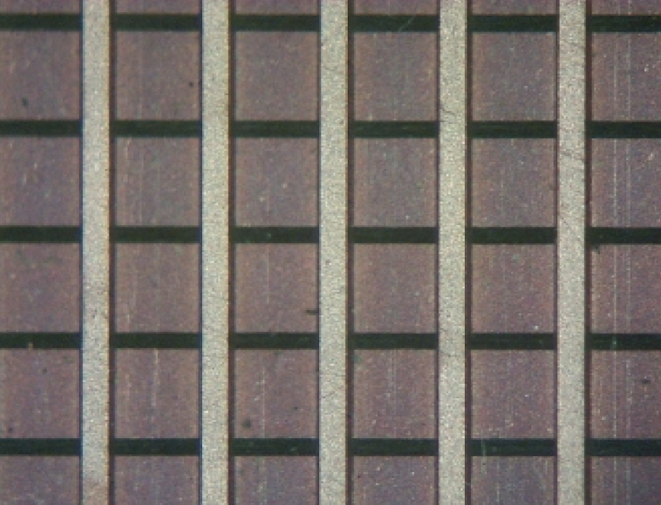
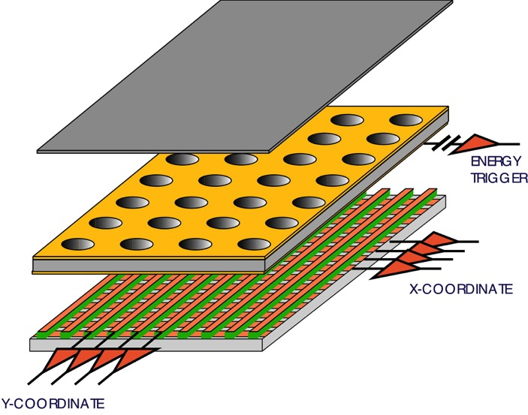
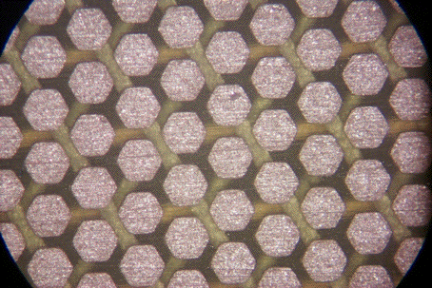
GEM
STANDARD XY READOUT 400 µm PITCH
GEM CHAMBER WITH
2-DIMENSIONAL READOUT
PAD MATRIX 500 µm PICH

Slide 21
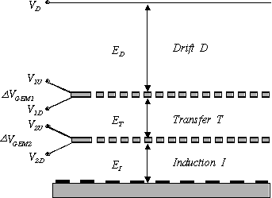
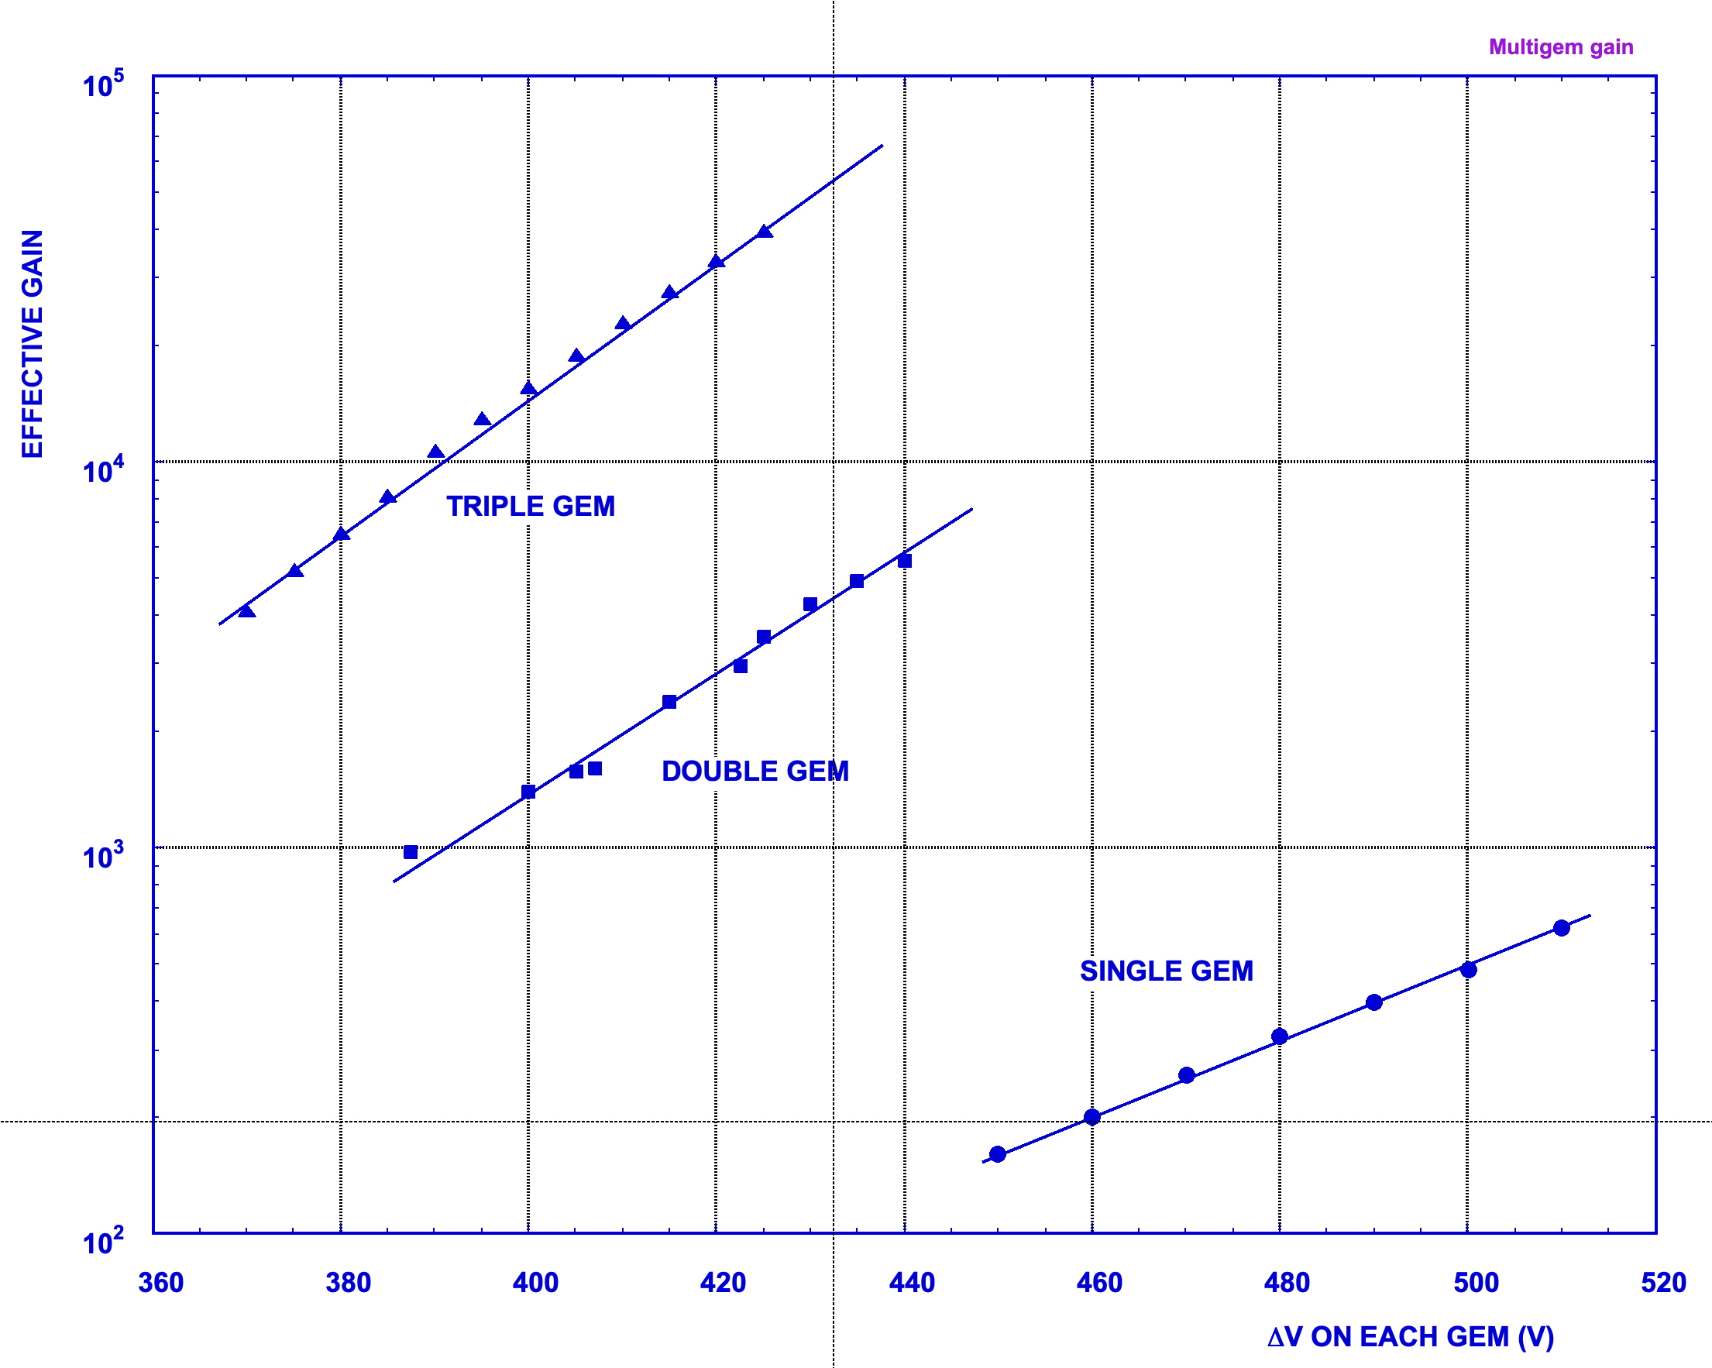
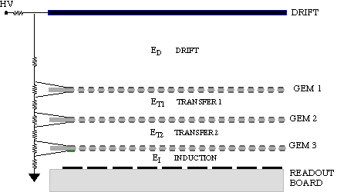
MULTI-GEM DETECTORS
LOWER VOLTAGE ON EACH GEM
HIGHER SAFE TOTAL GAIN
S. Bachmann et al, Nucl. Instr. Meth. A479(2012)294

Slide 22
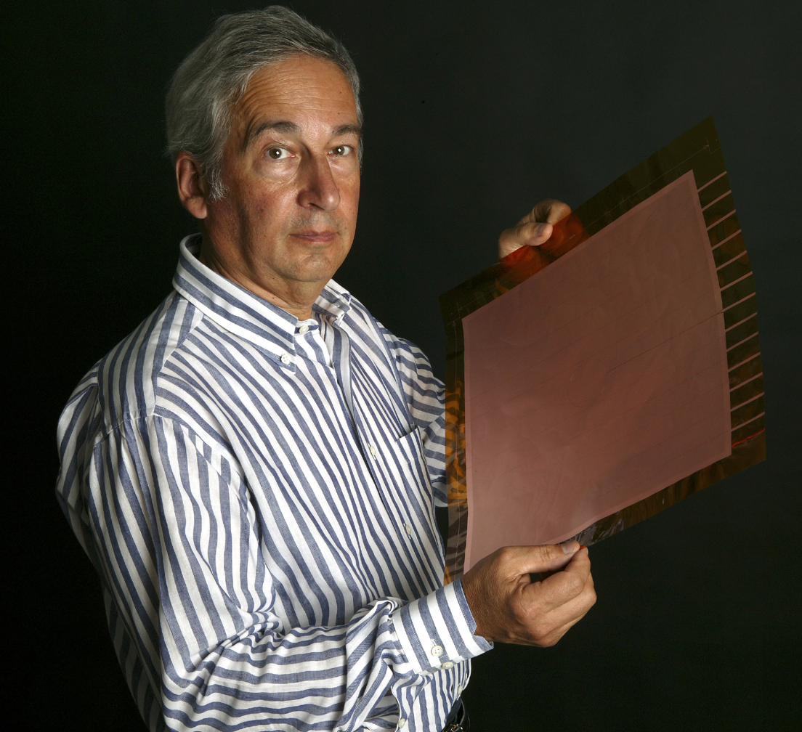
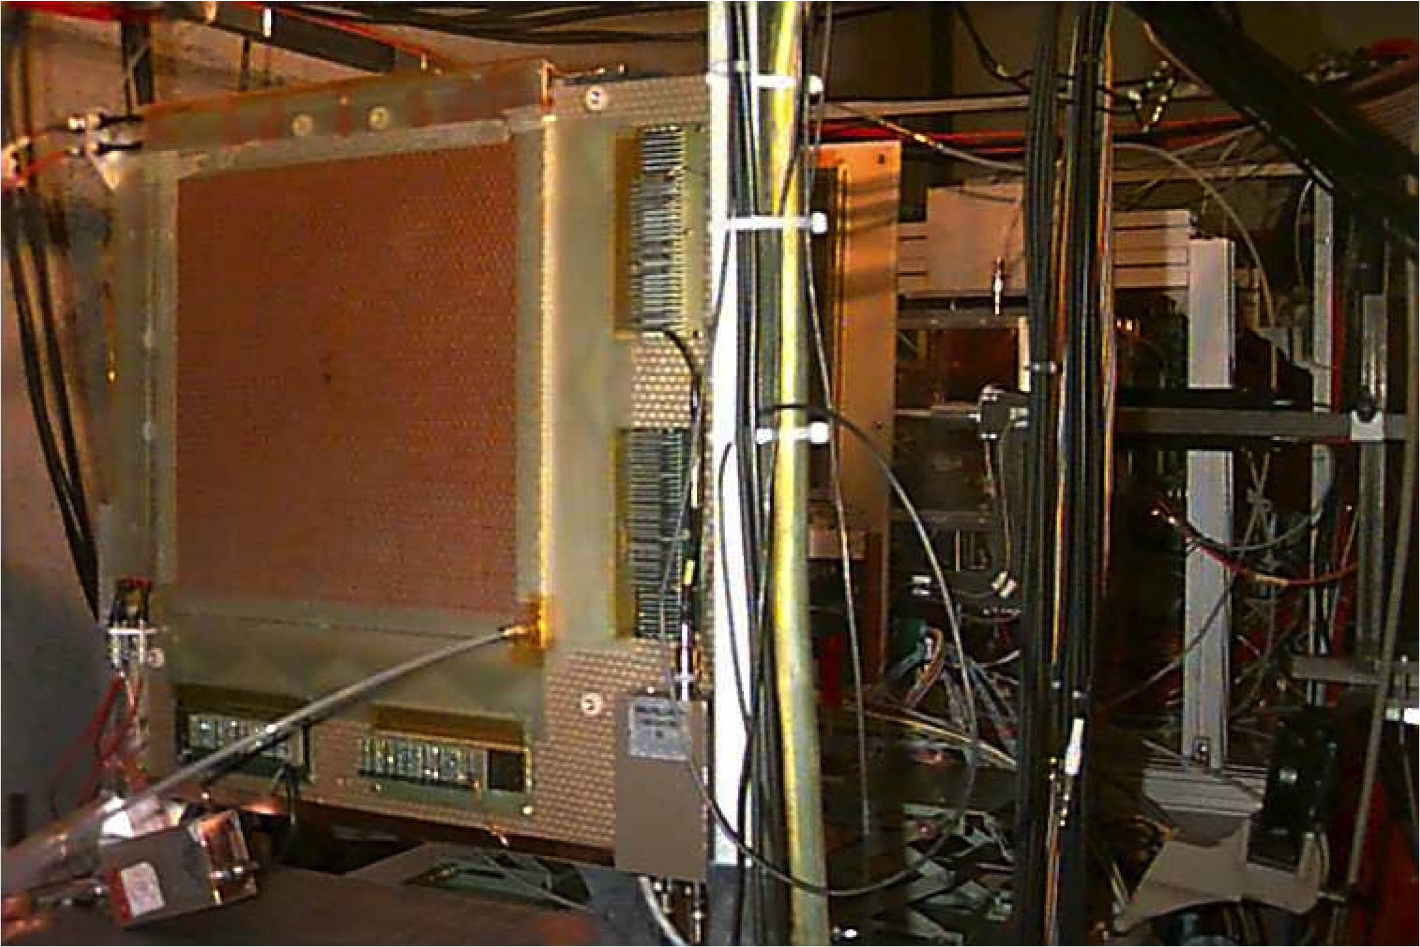
MULTI-GEM DETECTOR SYSTEMS
COMPASS TRACKER AT CERN (2001-2020)
A 30x30 cm² GEM ELECTRODE
~ 30 TRIPLE-GEM DETECTORS
30x30 cm² – 2-D Readout
C. Altunbas et al, Nucl. Instr. Meth. A490(2002)480

Slide 23
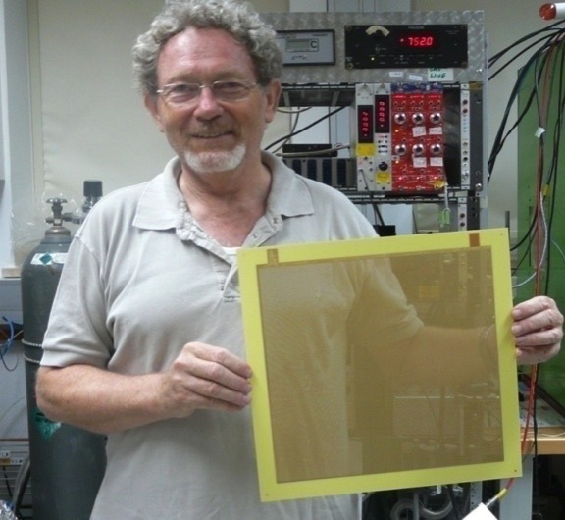
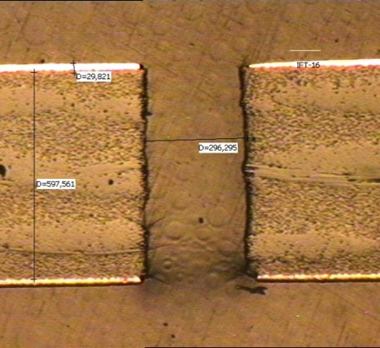
2004: THIK GEM (also LEM: Large Electron Multiplier)
MECHANICAL DRILLING OF METAL-CLAD PCB
1 mm THICK, 400 µm HOLES
R.Chechik et al
Nucl. Instr. and Meth. A535(2004)303

Slide 24


MULTI-GEM DETECTOR SYSTEMS
TRIPLE-GEM GEM DETECTORS
FOR TOTEM AT CERN
KLOE-2 INNER TRACKER
M.G. Bagliesi et al,
Nucl. Instr. Meth. A617(2010)134
A. Balla et al,
Nucl. Instr. Meth. A732(2013)221

Slide 25

2014-2024: CMS FORWARD MUON GEM UPGRADE
3 NEW STATIONS WITH TRIPLE-GEMs
CERN DETECTORS TECHNOLOGIES

Slide 26
CMS FORWARD MUON DETECTOR
INSTALLATION OF 36 SUPER-CHAMBERS FOR FIRST AND SECOND END-CAP
D. Abbaneo et al, Nucl. Instr. Meth. 918 (2019) 67

Slide 27


ALICE GEM TPC UPGRADE
87 cm
72 GEM MODULES
QUAD GEM FOR POSITIVE IONS SUPPRESSION
165 cm
J. Adolfsson et al, JINST16 (20210)P03021

Slide 28

ALICE TPC GEM UPGRADE

Slide 29


MPGD FOR UV PHOTONS DETECTION
GEM WITH REVERSE CsI PHOTOCATHODE
HADRON BLIND DETECTOR FOR PHENIX
T. Meinschad, L. Ropelewski and F. Sauli,
Nucl. Instr. Meth. A 535(2004)324
W. Anderson et al,
Nucl. Instr. Meth. A646(2011)35

Slide 30



HYBRID MPGD: GEM + MICROMEGAS
CHERENKOV RING IMAGING (COMPASS)
LARGE GAINS, REDUCED POSITIVE IONS BACKFLOW
CHERENKOV RING
J. Agarwala et al, Nucl. Instr. Meth. A952(2020) ﻿161832

Slide 31



HIGH RESOLUTION GEM: SOFT X-RAY POLARIMETRY
5.9 keV Photoelectron (80 µm pixels pitch):
~ 1 mm
L. Baldini et al,
Astroparticle Physics (2021)
R. Bellazzini et al,
Nucl. Instr. and Meth. A720(2013)173

Slide 32




OPTICAL GEMS: CARBON TETRAFLUORIDE SCINTILLATION
CF₄ SECONDARY SCINTILLATION
MeV α PARTICLES
n INTERACTIONS IN ³He
TRIPLE GEM
CCD CAMERA
F.A.F. Fraga et al, Nucl. Instr. and Meth. A478(2002) 357

Slide 33



OPTICAL MPGD IMAGING
GEM: BEAM IMAGER
SOFT X-RAY RADIOGRAPHY
MUON TRACKS
HADRONIC SHOWER
F. Brunbauer et al, JINST 13(2018)T02006

Slide 34



OPTICAL MPGD IMAGING
CYGNO:
DIRECTIONAL DARK MATTER SEARCH
Am-Be Source
D. Pinci et al,
Nucl. Instr. Meth. A936(2019)453

Slide 35


DUAL-PHASE LIQUID ARGON TIME PROJECTION CHAMBER
Proto-DUNE
C. Cuesta et al, ﻿arXiv:1910.10115v1(2019)

Slide 36


…AND TO KNOW MORE:

Slide 37

AND THE FUTURE?

